Slide 1
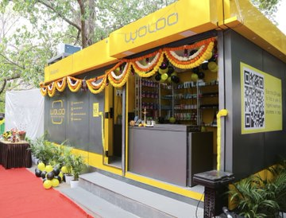
GRAMONNATI TRUST × WOLOO POWDER ROOMS × FUELADREAM
One Powder Room.
500 Women Served.
Every Day.
A Crowdfunding Campaign by Fueladream and Gramonnati Trust to Deploy 10 Smart Hygiene Facilities Across Bengaluru
80G Certified
CSR-1 Registered
Section 12AA Approved
Ayushi Sharma | Trustee, Gramonnati Trust
Ranganath Thota | CEO, Fueladream — India's trusted crowdfunding platform
Swachh Bharat 2.0 · Women Empowerment · Veterans Welfare · SDG 5 · SDG 6 · SDG 8

Slide 2

THE PROBLEM
"Every day, many women are forced to choose between their safety and their basic needs. That is not a personal problem. It is a public infrastructure failure."
India's Sanitation Crisis — And Women Pay the Price
$53.8B
Lost annually to poor
sanitation in India
World Bank
Women reduce water intake, skip meals, avoid travel — all to manage sanitation deprivation.
150M+
Women without safe
toilet access across India
12M+
Bengaluru population
with near zero hygienic public options

Slide 3
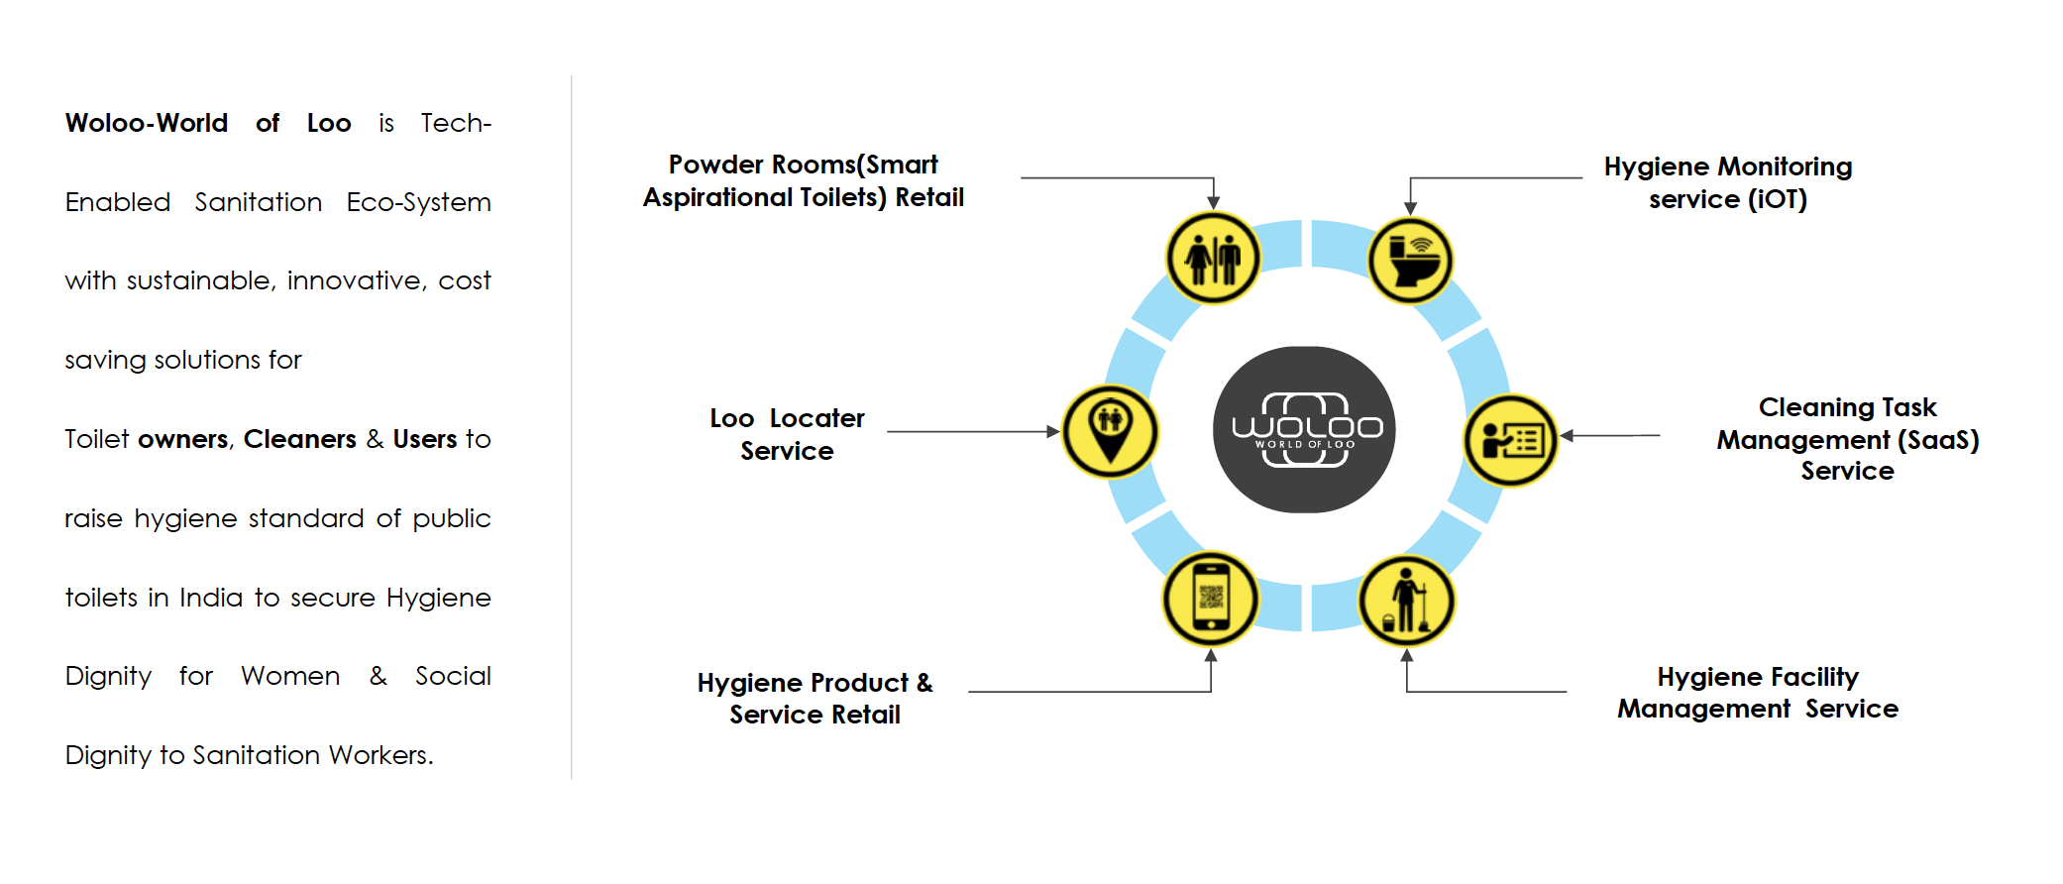
THE WOLOO ECOSYSTEM
India's Only Integrated Smart Hygiene Platform
SIX INTERCONNECTED SERVICES
PR
Powder Rooms
RET
Hygiene Product Retail
200 sqft smart aspirational toilets with retail — commercially viable, women-centric.
Women-centric products & services sold in-unit and via app. Revenue generator.
IoT
Hygiene Monitoring (IoT)
SaaS
Cleaning Task Management
Real-time stink detection, air quality sensors, usage counters, mobile alerts.
Digital janitor scheduling, audit trails, compliance dashboard for facility managers.
APP
Loo-Locater Service
FM
Facility Management
Find certified washrooms anywhere in India. 1L hosts across 800 cities.
Centralized management of multiple toilets — standards, QA, performance data.
Woloo — featured on Shark Tank India 2022 · IIMB NSR-CEL Incubation Winner · Monitor · Manage · Monetize

Slide 4
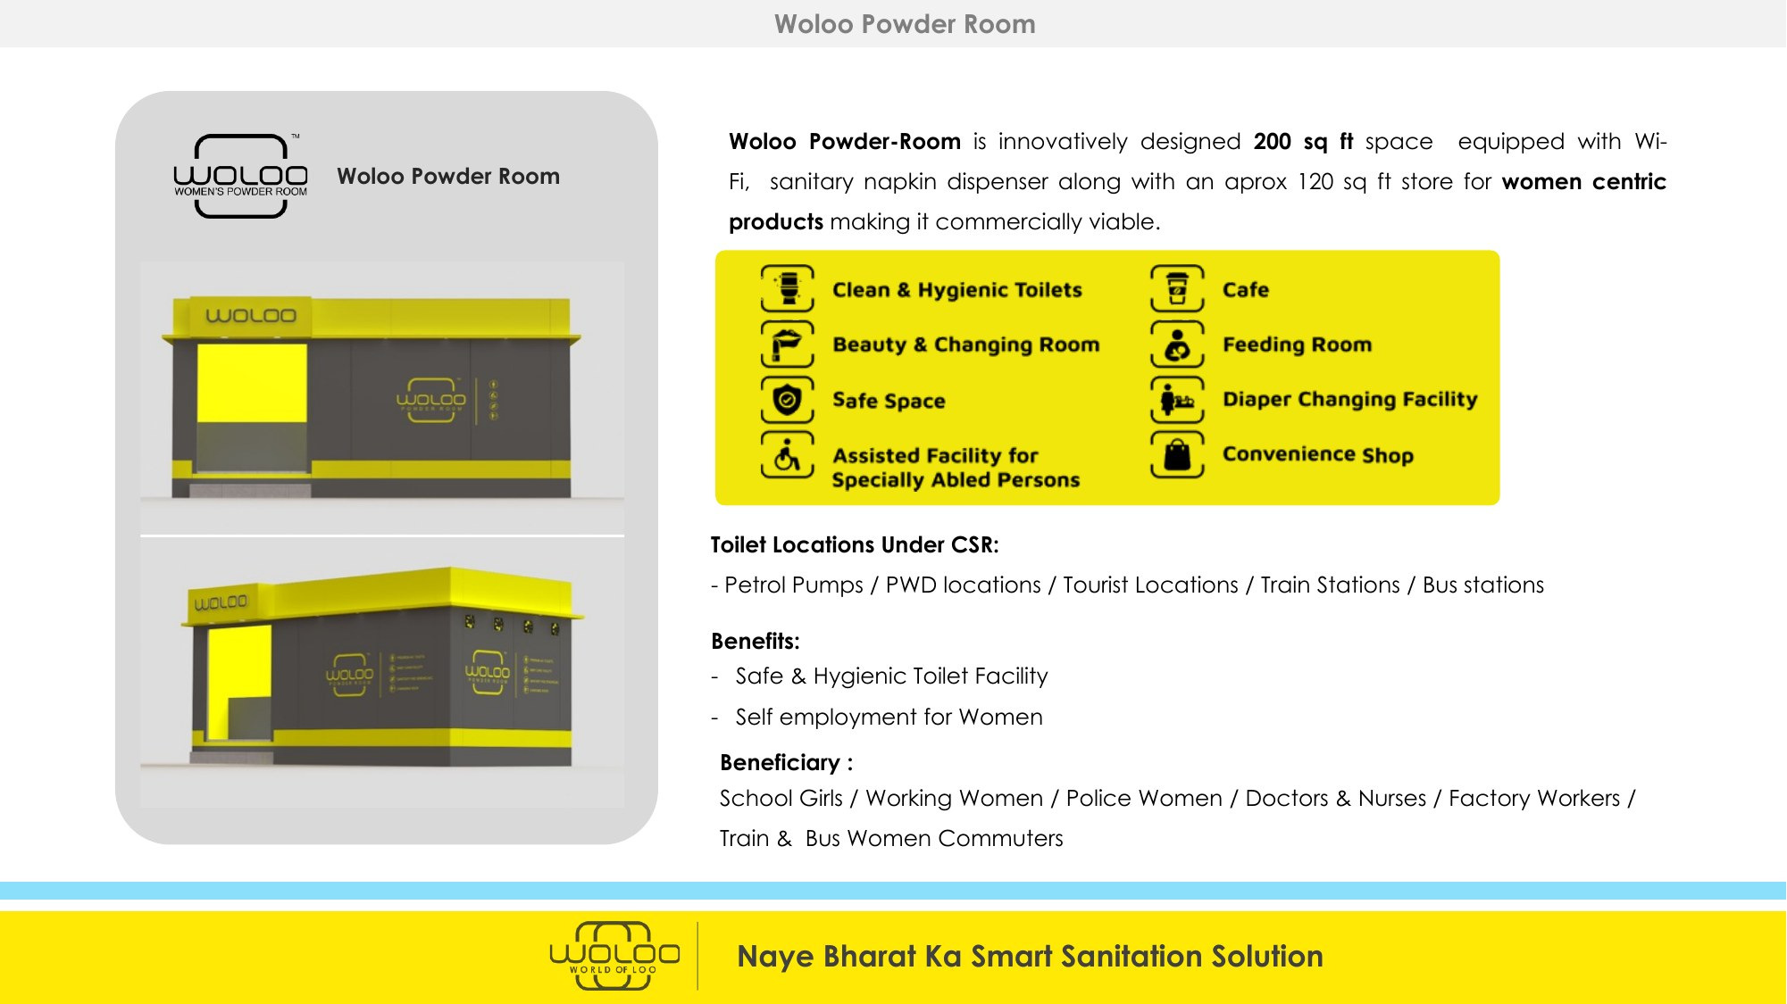
THE TECHNOLOGY STACK
Three products. One platform. Zero compromise on hygiene.
01
TASQ-MASTER
02
LOO-LOCATER
03
POWDER ROOM
IoT & AI Toilet Monitoring
Washroom Discovery App
Smart Hygiene Infrastructure
- Stink detector sensor
- Find certified washrooms anywhere
- 200 sqft aspirational facility
- Real-time mobile & web alerts
- Available in 800 cities, 10,000 pincodes
- Clean & hygienic powder room
- Digital cleaner task management
- 1 Lakh certified toilet host partners
- Beauty & changing area
- Centralized facility dashboard
- WAH-Score hygiene rating & reviews
- Cafe + convenience retail
- Usage analytics & historical data
- Navigation to nearest safe facility
- Baby & mother-care facilities
- Air quality measurement (IoT)
- Loo-discovery for women on the move
- Solar-powered, zero-waste
PAYING CLIENTS:
SCALE ACHIEVED:
- WAH-certified on Loo-Locater
- Jio-BP (62 devices · 1,600 facilities pipeline)
- 1 Lakh+ active app users
- SHG-operated, women-staffed
- IOCL (4 devices · 2,300 facilities pipeline)
- 26 paying corporate clients
46 Units Live
- BPCL (pilot done · 3,000 facilities pipeline)
- 3.5 Lakh employee subscriptions
- Cult.fit · Adani Airport · GMR · Mumbai Airport
- HUL · PhonePe · Nestle · Mondelez · P&G

Slide 5
THE SOLUTION: WOLOO POWDER ROOM
Shark Tank 2022
Not a toilet. A transformation.
WR
Clean Powder Room
WS
Women's Safe Space
200 sqft · Gender-segregated · Auto-flush · Sanitized after every use · Disability-friendly
Beauty & changing room · Feeding room · Baby care · Sanitary napkin dispenser
CF
Cafe + Convenience Store
IoT
IoT Smart Monitoring
Managed by Women SHGs . Personal care products · Beverages & snacks
Stink sensor · Air quality · Usage counter · Real-time alerts via TASQ-Master
WAH
WAH-Score Hygiene Rating
APP
Loo-Locator App
India's first people-powered toilet rating. Like CIBIL for cleanliness. Certified units.
61,000+ daily users · 700 cities · Navigate to nearest certified Powder Room
ECO
Sustainable Design
SHG
Women-Led Operations
Solar panels · Bio-digesters · Vertical gardens · Zero-waste operations
SHGs of ex-Servicewomen and War-widows run every unit. Dignified livelihoods, not just toilets.

Slide 6
WHERE DO WE PLAN TO SET UP WOLOO POWDER ROOMS
01
BPCL & HPCL Petrol Pumps
02
Railway & Bus Stations
FIRST DEPLOYMENT SITES
HIGH FOOTFALL
MoU signed nationally with Woloo.
Bengaluru sites being finalized for high impact.
Majestic, KSR, Yeshwantpur — lakhs of daily commuters. Women passengers have no safe, clean option on their journey.
03
Religious & Heritage Sites
04
Urban Markets & Hubs
TOURIST ZONES
ECONOMIC CENTRES
Lalbagh, Cubbon Park, temples, markets — tourist destinations with near-zero women's hygiene infrastructure.
KR Market, Jayanagar, Koramangala — Bengaluru's commercial heartbeat with thousands of women vendors every day.
Bengaluru is India's Silicon Valley. Its women deserve world-class hygiene infrastructure.

Slide 7
PROVEN AT SCALE — DE-RISKED FOR YOU
Beyond concept stage: Government mandates, paying customers, physical infrastructure operational.
46
1,77,204
Rs. 3.5 Cr
Powder Rooms Live
Women Walk-ins (Jan '26)
Revenue FY25-26 YTD
NHAI · Railways · Municipalities
10x growth since April
Multiple streams, growing MoM
1,03,909
702
1 Lakh+
Toilet Hosts On-boarded
Confirmed Pipeline Sites
Active App Users
800 cities · 10,000 pincodes
Petrol pumps · Railways · Tourism
Growing steadily since Mar 2022
TRUSTED BY:
Indian Railways · NHAI · IOCL · BPCL · HPCL · Mumbai Metro · Adani Airports · Gujarat Tourism · Goa Tourism
HUL · PhonePe · Nestle · Mondelez · P&G · Marico · Reliance · Zydus · GSK · Coca-Cola · Amazon · Walmart · Deloitte · CBRE

Slide 8
THE FORCE BEHIND THE MISSION
From Defending the Nation in Uniform to Serving the Nation Through Swachh Bharat
01
1 per 100 units
02
1 per 10 units
03
2 per unit
04
2 per unit
Zone Commander
Cluster Manager
Retail & Cafe Operator
Hygiene Attendant
Ex-Servicewoman (Retd Women Officers from Armed Forces
War Widow / Family Members of ex-servicemen
SHG Member
SHG Member
- City-level operations & govt coordination
- Daily management of 10-unit cluster
- Manages cafe counter & store
- WAH-standard cleanliness
- SHG training & mentoring
- Staff supervision & rostering
- Sells personal care products
- IoT sensor monitoring
- Zero-tolerance hygiene protocol
- Supply chain management
- Earns commission + salary
- TASQMaster task tracking
- Government liaison & compliance
- Revenue collection & IoT alerts
- Pathway to SHG ownership
- Stable, dignified livelihood
Your Rs.40L funds infrastructure. It also funds dignity — for those who already gave everything to this country. Jai Hind.

Slide 9
IMPLEMENTING PARTNER — GRAMONNATI TRUST
TRUST CREDENTIALS
Maj. VP Sharma (Retd.)
Founder & Managing Trustee
Founded
5th October 2017, Puducherry
Retired Army Major. Founded Gramonnati 2017. Architect of the Woloo-Gramonnati partnership. Champion of veteran welfare.
Founder
Maj. VP Sharma (Retd.)
Ayushi Sharma
80G Certified
Valid in Perpetuity (AY 2019-20)
Trustee – Women Empowerment
CSR-1 No.
CSR00017701 — MCA, Govt. of India
Leads all women empowerment programmes. Manages field operations and the Woloo women-operator model.
12A Status
Public Charitable Trust
Shyam Kaluve
Trustee – Technology
PAN
AACTG8992R
30+ years in Technology Industry. Deep experience in CSR Projects
Operates
PAN India · HQ Puducherry
Woloo Units
Deploying Bengaluru's first 10 units
Shrihari Allangala
Trustee – Finance & Strategy
30+ years in investment banking and private equity. Strengthens Gramonnati for large CSR partnerships.
Brig. Atul Sharma (Retd.)
Trustee – Armed Forces Coordination
35 years in Defence ICT. B.Tech. Expertise in large-scale programme management and governance.

Slide 10
THE BENGALURU CAMPAIGN
10 Woloo Powder Rooms · BPCL & HPCL Sites · Managed by Gramonnati Trust
10
Rs.40L
40
5,000+
Powder Rooms
Per Unit
Direct Women's Jobs
Women Served Daily
across Bengaluru
Construction + Operations
4 per unit
500+ per unit
DEPLOYMENT SITES
COST STRUCTURE
ONE CORPORATE = ONE UNIT
BPCL & HPCL petrol pump stations across Bengaluru. National MoU signed. Sites being finalized — ready to deploy within 60 days of funding commitment.
Rs.25L: Construction & setup — 200 sqft smart facility, IoT sensors, WAH certification, Loo-Locator listing.
Rs.15L: Operations — SHG training, War Widow salary, consumables, cafe setup.
Campaign structured as one corporate partner per Powder Room. Your Rs.40L fully funds one complete, operational facility — with contributor's names on ”Wall of Gratitude” , forever.

Slide 11
YOUR Rs.40 LAKHS — WHAT GETS BUILT & HOW YOU'RE RECOGNISED
Rs.40L BUILDS ONE COMPLETE POWDER ROOM
THE GRATITUDE WALL — YOUR RECOGNITION
Rs.25L
Construction & Setup
Rs.40L
CORPORATE FUNDER
- 200 sqft smart hygiene facility at selected high foot-fall sites
✓ Powder Room naming rights (permanent)
- IoT sensors & stink detection (TASQ-Master)
✓ Premium plaque at site + Woloo app badge
✓ Live IoT impact dashboard access
- WAH-Score certification & Loo-Locator listing
✓ Co-branded CSR + BRSR report + Carbon credits
- Solar panels, bio-digester, accessibility ramps
Rs.5L+
MAJOR DONOR
Rs.15L
Operational Support (until self-sustaining)
✓ Gold tier Gratitude Wall plaque
- War Widow Cluster Operator: 12 months salary
✓ 80G certificate + annual impact data
- SHG training & onboarding (4 women per unit)
Rs.1L+
TEAM / EMPLOYEE POOL
- Cafe setup, consumables & supply chain
EVERY UNIT: 500+ women served daily · 4 dignified jobs · Carbon credits · Self-sustaining in 12-18 months
✓ Silver tier — team name on Gratitude Wall
- TASQ-Master tech platform: 12-month subscription
✓ 80G for all individual donors

Slide 12
ESG FEATURES & INDIVIDUAL / CORPORATE TAX BENEFITS
VII
Schedule VII — CSR Eligible
80G
80G: 50% Tax Deduction
ESG
BRSR-Ready Data Pack
Qualifies under: Sanitation (Swachh Bharat), Women Empowerment, Rural Development, Environment Sustainability
Every rupee donated earns 50% income tax deduction under Section 80G. Applicable for corporate and individual donors.
Annual ESG disclosure data delivered. SDG KPIs mapped to IRIS+ framework. Format ready for SEBI BRSR filings.
CO2
Carbon Credit Certificate
IoT
Live Impact Dashboard
AUD
Full Audit Transparency
India CCTS-compatible MRV data. IoT-measured impact. Verifiable carbon credits issued per unit for your ESG report.
Real-time unit-level access from Day 1. Walk-ins, hygiene scores, women served, jobs created — your impact, live.
Annual CA-audited utilisation report. CSR-1 compliance documentation. IRIS+ verified KPIs. Zero ambiguity.
FuelADream: Secure · Transparent · FCRA/CSR Compliant · Every rupee tracked | www.fueladream.com

Slide 13
MEASURABLE IMPACT — SDG FRAMEWORK & REPORTING
SDG 3
Good Health
SDG 5
Gender Equality
SDG 6
Clean Sanitation
- Hygiene incidents reduced per site
- Women served per month per unit
- Certified WAH-score units
- Air quality monitored (IoT)
- SHG jobs created & sustained
- ODF+ designated sites
- Communicable disease risk reduced
- Safe spaces built in public areas
- Sanitation access visits per period
SDG 8
Decent Work
SDG 11
Sustainable Cities
SDG 13
Climate Action
- SHG monthly income levels
- Govt PPP infrastructure installed
- tCO2e avoided (IoT MRV data)
- Hygiene attendant earnings
- Public utility gap addressed
- Carbon credits issued per unit
- 40 jobs over 10 units
- Safe commute for Bengaluru women
- Solar & bio-digester impact
All KPIs per IRIS+ Standards · Live dashboard for all CSR partners · Annual CA-audited report · BRSR-ready data pack delivered

Slide 14
HOW TO START
Be Bengaluru's First.
01
Expression of Interest
Email ved@gramonnati.org / ranga@Fueladream.com
Receive full due diligence pack
Non-binding — no commitment yet
Fund the first Woloo Powder Room
in Bengaluru's history.
02
Meeting with Fueladream and Gramonnati for Crowd-funding Campaign
Fueladream Approach to Crow-funding Campaign
Finalize the details of the Campaign
Donate or pledge your unit
GRAMONNATI TRUST
Maj. VP Sharma (Retd.) | Founder & Chairman
03
Customise Your Crowdfunding Plan
+91 80959 99776 | ved@gramonnati.org
Site selection · Naming rights
SDG mapping · Disbursement schedule
Tailored to your company with Fueladream
www.gramonnati.org
FUELADREAM PLATFORM
04
Campaign Launch & Groundbreaking
Ranganath Thota | Founder & Chairman
Campaign live on Fueladream
Construction starts in 60 days
Measure impact on app — live from Day 1
+91 99088 99111 | ranga@fueladream.com
www.fueladream.com
80G · CSR-1 · Schedule VII · BRSR-Ready · SDG Aligned

